Slide 2
STEM FUNDAMENTAL
SESSION NO: 3
TOPIC OF THE DAY: Kaleidoscope
LEARNING TARGET: Reflection of Light

Slide 3
Kaleidoscope

Slide 4
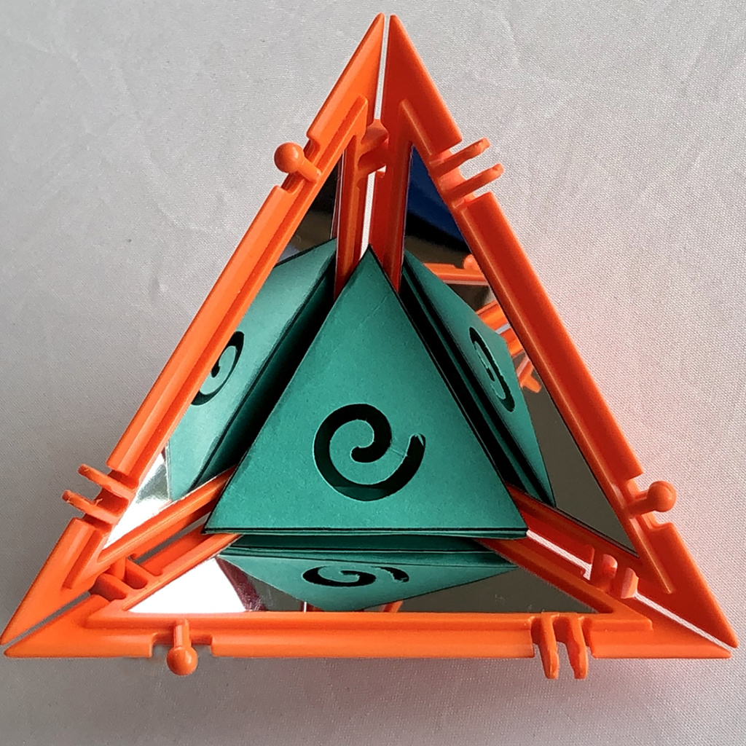
A kaleidoscope is a pattern of mirrors containing loose, colored objects such as beads or pebbles and bits of glass.

Slide 5
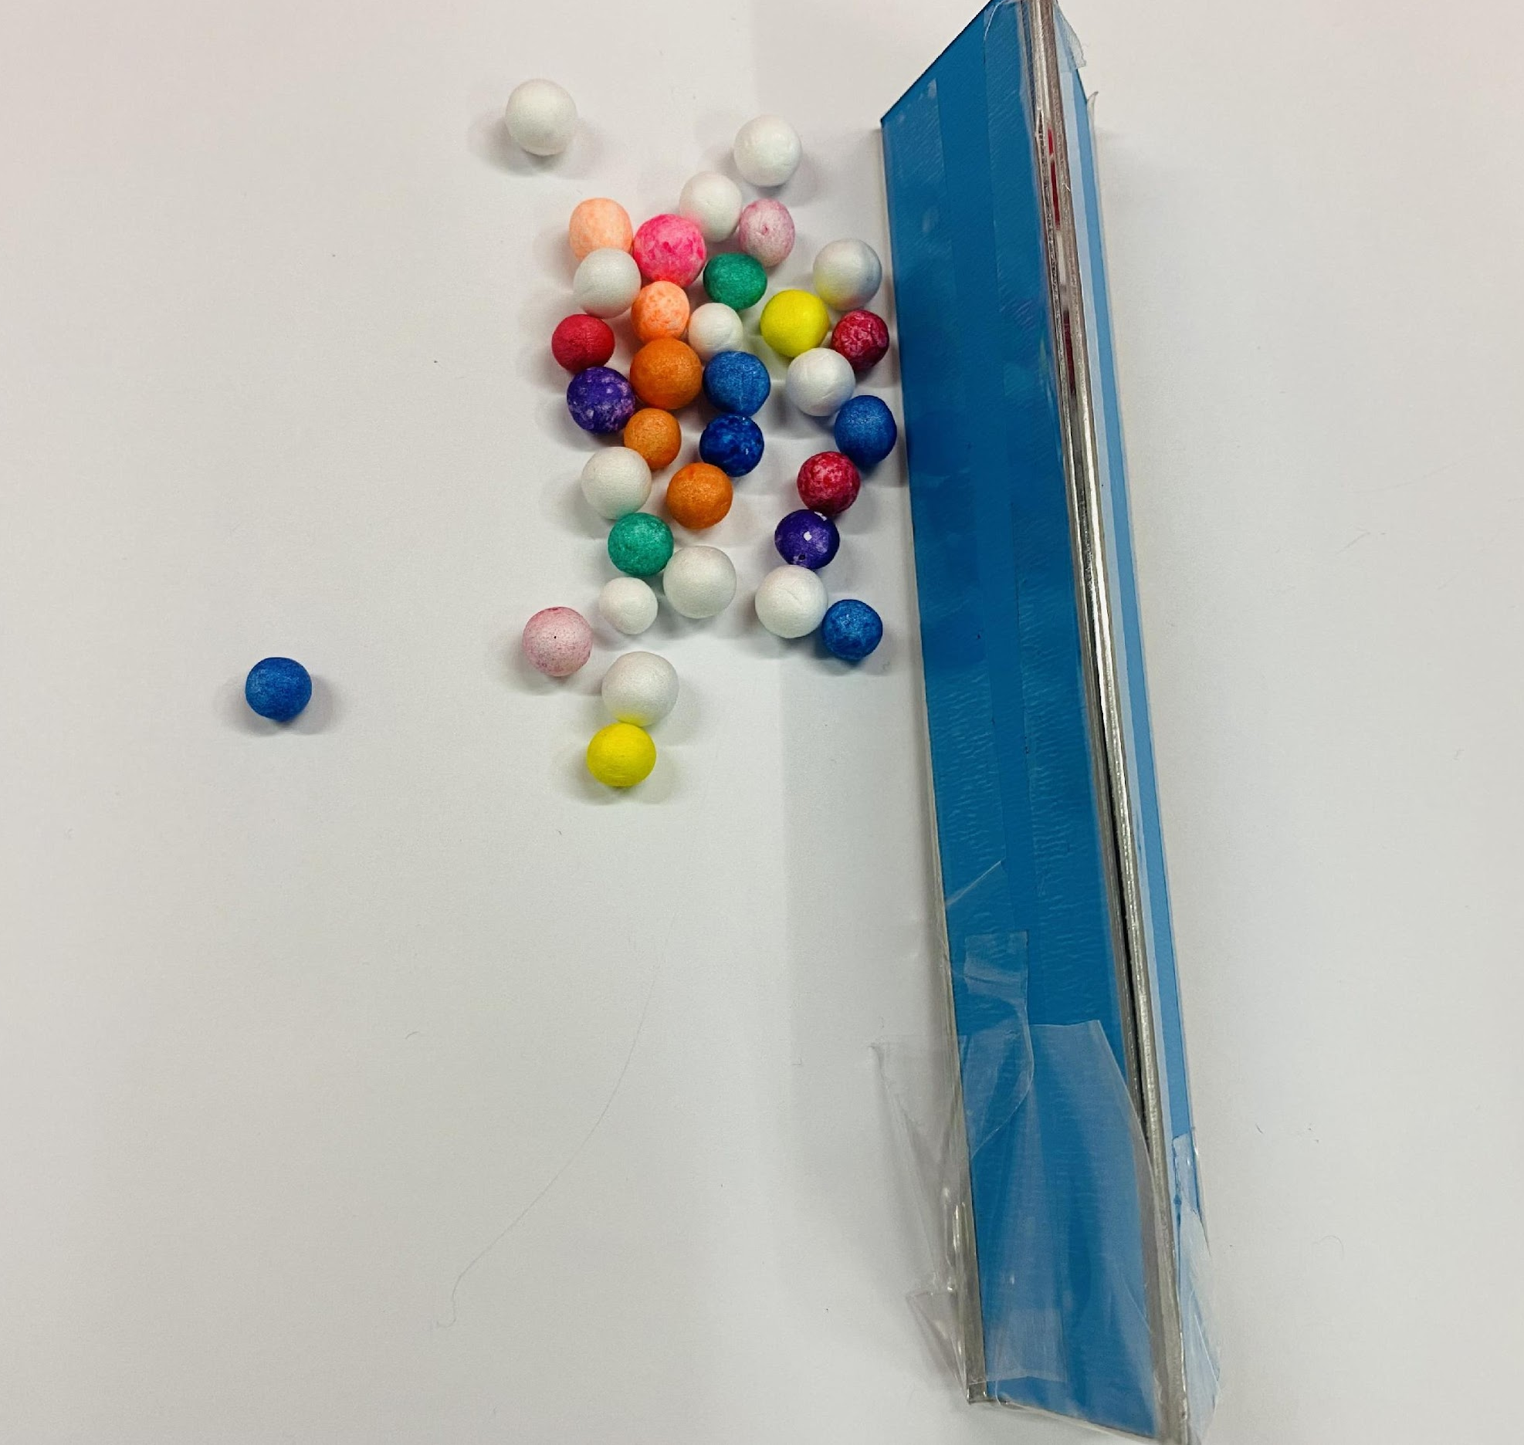
Let’s make our Kaleidoscope

